Slide 1
IT354 project My Recipe box
Satoko Kora

Slide 2
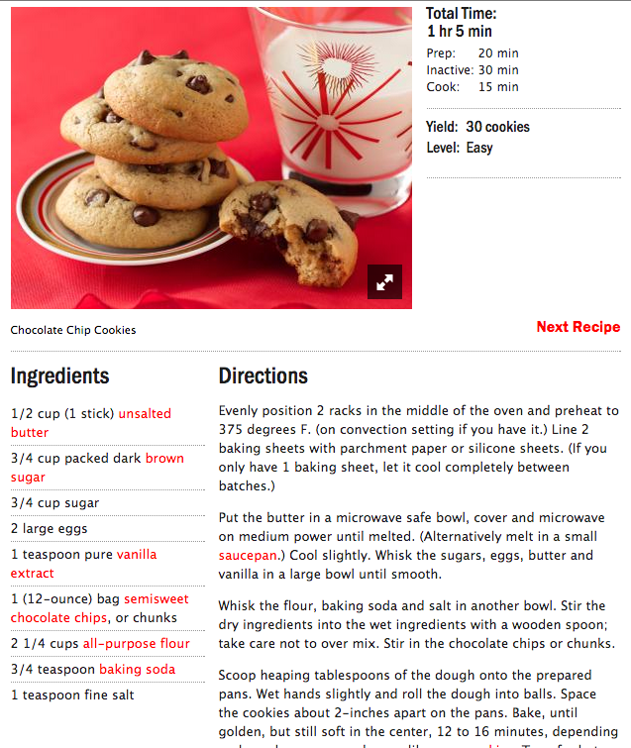
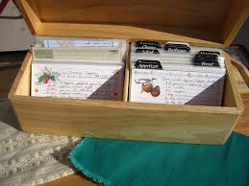
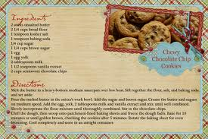
Ideas about my application
Recipe cards + Online recipe sites
Recipe cards: consistent format, but less accessibility
Online recipes: full accessibility, but layout varied by cooking recipe websites

Slide 3
Research and decision-making
Use Cases
Create a new recipe card
Store recipe cards
View recipe cards
use of content management system and customize it
Search for recipes
=> Use of Cooking Recipe API
Get instructions of the recipe
=> Web page text scraping
Notes:
Word press online blog cms let users to easily post articles and publish them

Slide 4



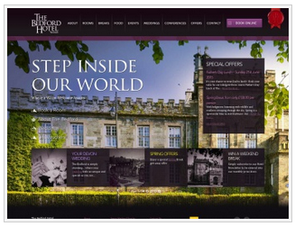
Used tools & technologies
Content Management System: WordPress
Free and open source blogging tool
=> content management system
Written in PHP, with MySQL
A variety of themes and plugins => increased usability

Slide 5
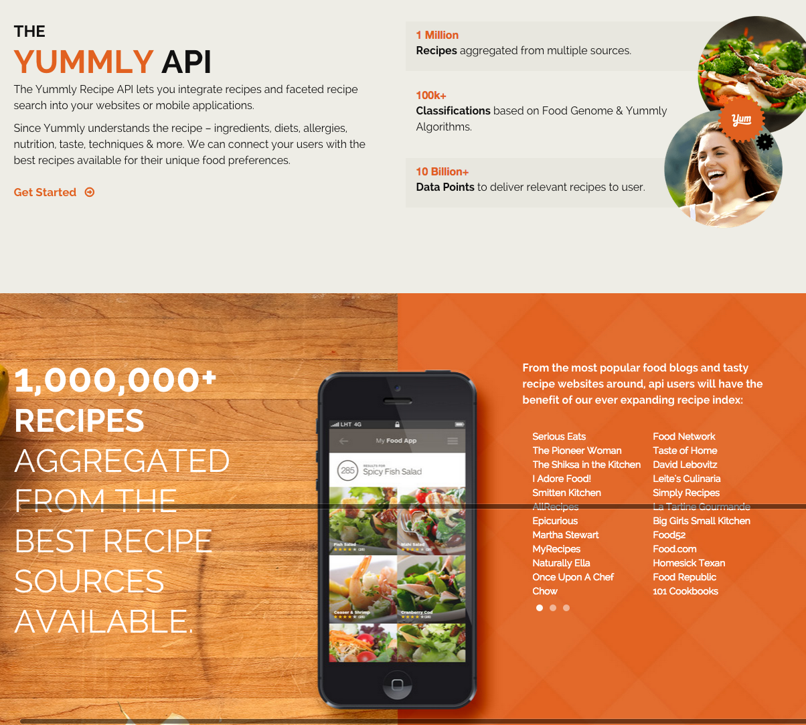
Used tools & technologies
Cooking recipe API: Yummly API
Rest API
JSON type data
2 kinds of data
Search Recipes API call
Get recipe API call

Slide 6
Used tools & technologies
Web page scraping in PHP
// Get content of the page
$text = file_get_contents($URL);
// Find where to retrieve text
$start_position = strpos($text, “<div>Instructions”);
$end_position = strpos($text, “</div>”);
// Retrieve a part of the content
$instruction = substr($text, $start_position, $end_position);

Slide 7

DEMO

Slide 8
Future Challenges & lessons learned
Additional functionalities to add
Sign in / Sign up
More accurate logic for text scraping
Sort by categories
Balance time for development
buffer for unexpected problems
Spent a lot of time to understand WordPress architecture and available methods

Slide 9
Thank you
Questions?

